Slide 1
Achieving Diagnostic Excellence
Resources for Hospitals
October 18, 2024

Slide 2
Webinar Reminders
Accessing the Audio
  If you are using computer audio, please select that option in the audio options pop up.
  If you are joining by phone, please dial in using the Toll Free 800 number provided. Then enter the Meeting ID when prompted, then your Participant ID.
    The Meeting ID can be found in the confirmation email or in the Zoom meeting by clicking the audio button in the bottom left-hand corner.
    The Participant ID can be found in the audio options in the bottom left-hand corner.
    If you forgot to enter the Participant ID when dialing in, please dial # then your Participant ID again followed by #.
Use of the Zoom Chat Function
  The Town Hall Call includes a live Q&A during the presentation; therefore, we do not monitor the chat for questions. Please reserve the Zoom Chat Function for reporting technical issues only.
Accessing the Slides & Recording
  Following each session, a copy of the slides and recording will be posted and available for download on the Leapfrog website here: https://www.leapfroggroup.org/survey-materials/town-hall-calls
Notes:
Just a couple housekeeping notes before we get started. We’ll make the slides and recording available to you all after the presentation. Please reserve that “Chat” function for letting us know about a technical issue, like if the audio cuts out or the slides aren’t advancing. For any kind of content-related questions, please use the QandA function – that’ll help us keep better track of your questions.

Slide 3


Q & A
Participants will be able to ask questions during the presentation. Please select the Q&A icon at the bottom of your screen:
  Once the icon has been selected a Q&A box will appear for you to type your questions.
  All participants will be able to view the questions and answers during the duration of the webinar.
  We will answer questions live during breaks in the presentation.
Following each presentation we will have a live Q&A session. Please use the Raise Hand icon at the bottom of your screen:
  Once the icon has been selected you will be placed in the queue. When it is your turn to ask your question, you will receive a prompt from the host asking you to unmute yourself.
Notes:
In case you had any questions about that – there’s the QandA icon on your screen, and after we conclude the presentation we’ll have an opportunity for you all to raise your hands and ask questions in the chat.

Slide 4


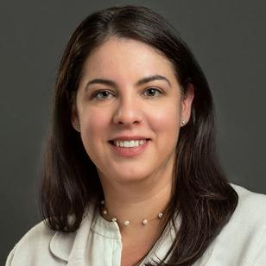

Introductions
Sangeeta Ahluwalia, PhD, MA, MPH
Senior Policy Researcher
RAND
Courtney Gidengil, MD, MPH
Senior Physician Policy Researcher
RAND
Jean-Luc Tilly, MPA
Program Director
The Leapfrog Group
Mark Graber, MD, FACP
Founder
Community Improving Diagnosis in Medicine
Notes:
Alright, let’s get started. I’ll ask each panelist to introduce themselves. Mark, can we start with you?

Slide 5
Resources on Diagnostic Excellence
Implementing Diagnostic Excellence Across System (IDEAS)
  Calibrate Dx,
  Measure Dx, and
  The Toolkit for Engaging Patients to Improve Diagnostic Safety
Root Cause Analysis of Cases Involving Diagnosis: A Handbook for Healthcare Organizations
First Field Report: Diagnosis in the 2024 Hospital Survey
Notes:
Alright so before I turn it over to our first presenters, here’s just a quick outline of what we’ll cover today. The goal is to give you all an idea of what kinds of resources are available to you as you start to think about pursuing diagnostic excellence in your hospital. You’ll learn about a few key tools that AHRQ has recently made available, and how you can engage with those substantively. You’ll learn about a new resource created by Dr. Graber and sponsored by Leapfrog. And then finally I’ll fill you in on what we’ve found in our first year collecting data on diagnosis in the Hospital Survey.

Slide 6



Implementing Diagnostic Excellence
Across Systems (IDEAS) Project
D2D9E4
D2EAF0
E3D8E5
D9D9D9
002E6D
0190B3
84D0DD
691F74
Cecilie_Arcurs/Getty Images
Leapfrog Group, October 18th, 2024

Slide 7

Diagnostic safety is critically important
Diagnostic safety events contribute to preventable harm in 1 in 20 outpatient visits and up to 250,000 inpatient stays each year
They are the most common root cause for medical liability claims
Healthcare organizations and clinicians need actionable, practical, and flexible resources to support diagnostic safety improvement efforts.
Sturti/Getty (E+)
Singh et al. BMJ Qual Saf. Sep 2014;23(9):727-731.
Gunderson et al. BMJ Qual Saf. 2020 Dec;29(12):1008-1018.
Hanscom et al. Coverys.com. March 13, 2018.

Slide 8

AHRQ is committed to improving diagnostic safety
The Agency for Healthcare Research and Quality (AHRQ) has developed diagnostic safety resources to support the delivery of high-quality healthcare
Resources were created by Baylor College of Medicine and MedStar Health for AHRQ; tested with clinicians at multiple institutions
RAND is leading the IDEAS Project, an AHRQ-funded national effort to recruit healthcare organizations to implement up to three diagnostic safety resources
SDI Productions/Getty (E+)

Slide 9








IDEAS supports diagnostic safety across settings and users
NIKCOA/Adobe Stock; C Malambo/Adobe Stock; SDI Productions/Getty
Toolkit for Patients To Improve Diagnostic Safety
Measure Dx
Calibrate Dx
SETTING
Office-based setting
Any healthcare setting
Any healthcare setting
USERS
Clinicians and their patients
QI or patient safety teams
Individual licensed clinicians whose scope of practice includes diagnosis

Slide 10
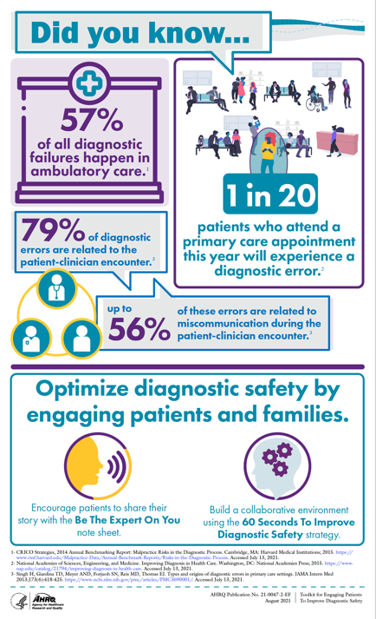
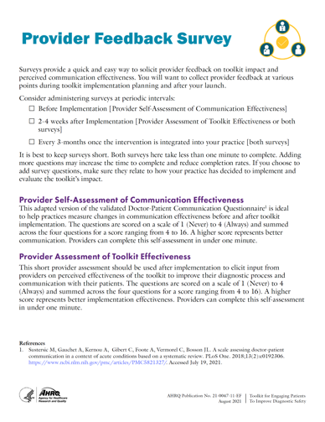
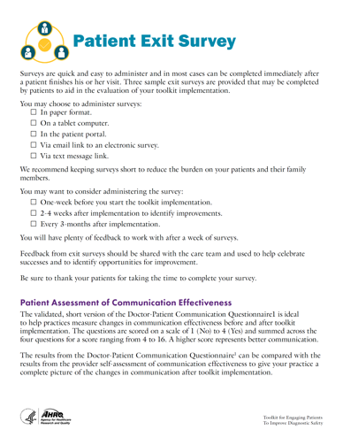
Toolkit for Engaging Patients To Improve Diagnostic Safety
Combines two easy-to-launch approaches to improve patient-clinician communication
VALUE ADDED
Engage patients directly, increase patient satisfaction, and enhance clinician reflection to reduce diagnostic harms in office-based practices

Slide 11
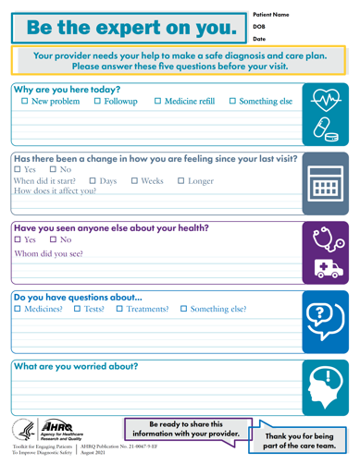
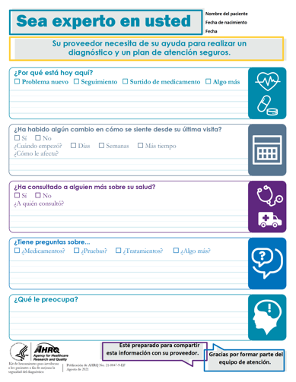
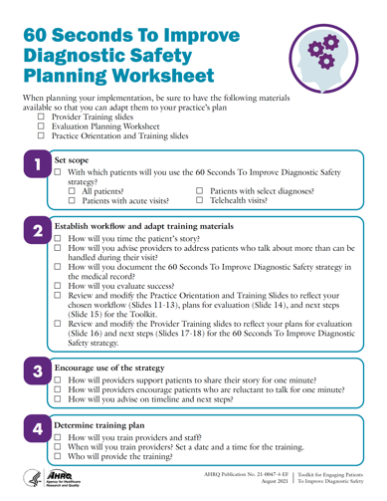
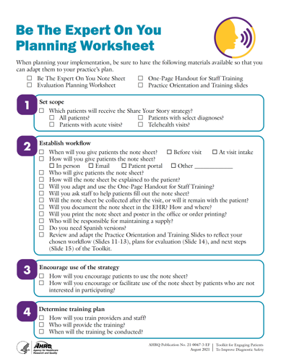
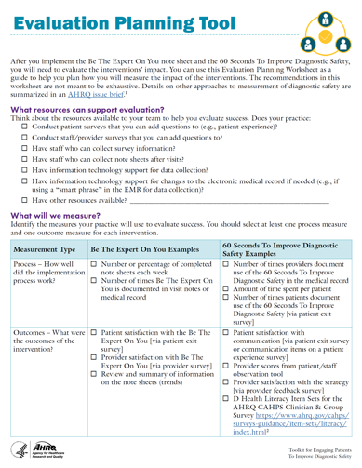
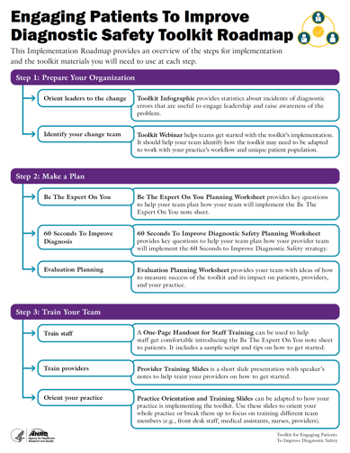
Toolkit has two components
1
2
  Be The Expert On You
  Patient-facing component
  60 Seconds To Improve Diagnostic Safety
  Clinician-facing component

Slide 12

Who can test the Toolkit
Any office-based practice with at least two to three clinicians
Primary care and specialty practices of any type
SDI Productions/Getty

Slide 13
We read through the 60 Seconds for Safety tool and we teach it to each to make sure we are all comfortable with it…the tool just makes a lot of sense… good practice
in any setting.
–Toolkit user
Really, it’s very, very simple. It’s as simple as it looks…and really brings you back to what’s important in that encounter – the relationship.
–Toolkit developer
Some of our clinicians talk(ed) about how it reminded them why they got into medicine, to sit and listen and reflect…in the time of record physician and healthcare worker burnout, this tool helped us bring the patient and clinician back closer together.
–Toolkit developer

Slide 14

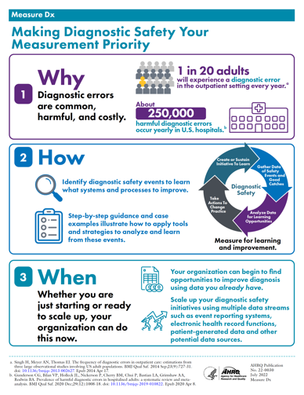
Measure Dx
Helps quality improvement (QI) teams identify and use measurement strategies to detect, analyze, and learn from diagnostic safety events
VALUE ADDED
Use existing data to reduce diagnostic harms at an organizational level

Slide 15

Measure Dx guides QI teams through four steps
Sturti/Getty (E+)
1
2
3
4
  Prepare
  organization for diagnostic safety measurement
  Assess
  organizational readiness (i.e., self-assessment)
  Decide
  on a measurement strategy
  Review
  and analyze cases of interest

Slide 16

Who can test Measure Dx
Any healthcare setting or site, including those new to learning about diagnostic safety
Sites that have or that can create a QI team with access to patient-level data
Entire ambulatory clinics or hospitals or specific units (e.g., emergency departments, intensive care units)
C Malambo/Adobe Stock

Slide 17
The project became an opportunity, it really put some structure around what we were going to do. It was a vehicle to get safety leadership in the hospital to come on board.
–Measure Dx pilot user
It was very easy for me to follow. I like the fact that I could share a document with the team, which had everything laid out
very easy to understand.
–Measure Dx pilot user
One of the things that's very clear in the tool is you don't have to solve all these problems. Start small, pick an area you want to focus on, and start with the resources that you have.
Being able to fit the resource to people's local environment is huge. MeasureDx does a good job of helping with that.
–Measure Dx pilot user

Slide 18

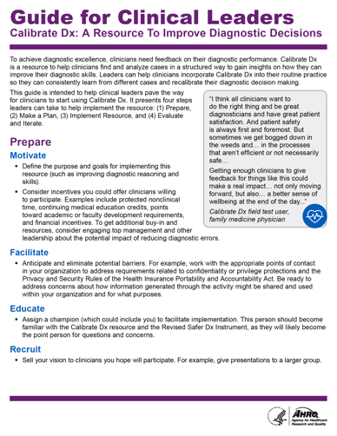
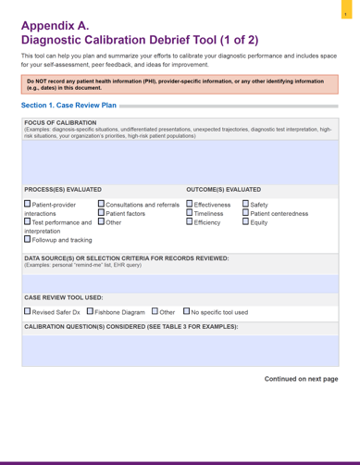
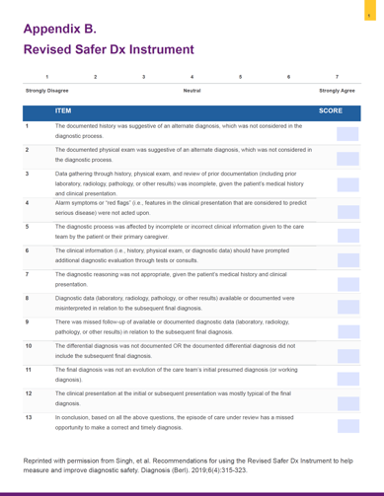
Calibrate Dx
Guides clinicians in reviewing cases, reflecting on their diagnostic performance, and debriefing with trusted colleagues
VALUE ADDED
Empower clinicians to learn from their own clinical practice through structured exercises and tools

Slide 19

Calibrate Dx guides clinicians through 4 steps
Gorodenkoff/Getty (iStock)
1
2
3
4
  Specify
  an area of practice (e.g., high-risk situations, commonly missed or delayed diagnoses)
  Evaluate
  3–5 of their own cases for learning opportunities
  Plan and apply
  improvement strategies and begin to take actions
  Reflect
  on this calibration exercise over time

Slide 20

Who can test Calibrate Dx
NIKCOA/Adobe Stock
Sites with at least four to six clinicians willing to commit to testing Calibrate Dx
Small and large group practices, departments within clinics or hospitals, and physician or other clinician training programs

Slide 21
So, I think it’s helped me reason more and explain more of my reasoning in my documentation. I also think it’s helped me naturally think about other factors at play in my own decision
–Calibrate Dx pilot user
This is awesome. Like I'm absolutely going to keep using this.
–Calibrate Dx pilot user
Hearing the reinforcement from my colleague and recognition of, ‘this sounds like it was a really challenging case, but you did the best that you could, maybe here’s one or two things that I would’ve done differently that you could apply in the future.’ I think it was good camaraderie building and also reinforcement that…we did the best we could.
–Calibrate Dx pilot user

Slide 22

Why participate in IDEAS?
Implement innovative methods for advancing diagnostic safety
Improve care, minimize risk of harm
Receive tailored support and training on the AHRQ resources
Connect with the project’s Learning Collaboratives
Reduce opportunities for legal claims and lawsuits
Obtain free continuing education (CE) credits
Engage in Maintenance of Certification (MOC) improvement activities
Receive a modest stipend
FatCamera/Getty (E+)

Slide 23

What support will IDEAS provide?
Flexible training for all sites including resource-specific materials and tip sheets
CE credits and ABMS-approved MOC credits
Hands-on assistance including dedicated email for questions and “office hours” with content experts
Learning Collaboratives with other participants
Feedback on the impact of the intervention (available to participants at end of study)
Ridofranz/Getty (iStock)

Slide 24

What is needed to participate?
Commit to this 2-year effort
Demonstrate executive support
Identify site participants; engage in project and data collection activities
Identify a site champion to help coordinate project activities and communicate with the project team
Obtain approvals or submit approval to defer to RAND’s IRB
Identify site-specific contacts who can help troubleshoot privacy, security, or confidentiality barriers
Jacob Wackerhausen/Getty (iStock)

Slide 25
Implement multiple resources with staggered starts
69B5C9
D2D9E4
D2EAF0
E3D8E5
D9D9D9
97A6BC
926499
2024
2025
2026
2027
S | O | N | D | J | F | M | A | M | J | J | A | S | O | N | D | J | F | M | A | M | J | J | A | S | O | N | D | J | F | M | A | M | J | J | A | S
RECRUITMENT: National, Rolling
Toolkit for Patient Engagement
Training | Implementation | Sustainability
Measure Dx
Training | Implementation | Sustainability
Calibrate Dx
Training | Implementation | Sustainability

Slide 26
Summary: Resource-specific considerations
March 2025
June 2025
August 2025
Toolkit for Patient Engagement
Measure Dx
Calibrate Dx
  Two to three clinician participants to use the resource in routine practice
  Participate in data collection activities for the evaluation
  Involvement of administrative office staff to collect brief, anonymous patient surveys
  QI team with (1) a clinical lead with diagnostic expertise and (2) a quality manager with operations expertise
  Participate in data collection activities, many of which could be done during QI meetings or scheduled activities
  Four to six clinician participants who perform quarterly reviews of a sample of their own cases
  Complete brief quarterly surveys and provide feedback on the resource
  Clinician access to electronic health record data for case reviews

Slide 27

Want to learn more?
VISIT: https://www.ahrq.gov/ideas-project/
EMAIL: Courtney Gidengil, MD, MPH
Sangeeta Ahluwalia, PhD
IDEASproject@rand.org

Slide 28
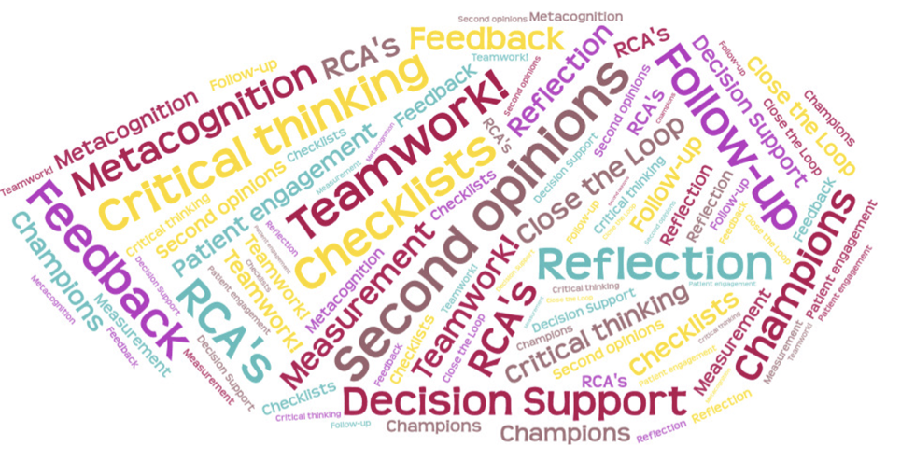

RCA Handbook
Mark L Graber, Gerry Castro, et al

Slide 29

RCA’s of Diagnostic Error
You ALL know how to conduct a RCA
But…..
Have you studied cases of diagnostic error?

Slide 30
RCA’s of Diagnostic Error -- Why now?
Diagnostic error is the #1 patient safety concern in healthcare today – ECRI
All healthcare organizations need to address the harm associated with diagnostic error.
  NAM
  WHO
  CDC
Diagnostic error is a top 10 cause of death in the US, over 250,000 deaths/year. (Newman-Toker et al. BMJ 2024: 33;2)

Slide 31
RCA’s of Diagnostic Error -- Finding them
No: Incident reports
Yes:
Ask patients
Ask clinicians
Use “Trigger tools”

Slide 32
RCA’s of Diagnostic Error vs other safety events
What’s the same | What’s different
CEO\CMO charge | Start IMMEDIATELY
RCA2, TJC, ASHRM tools – all good | Include the clinicians involved
Study the SYSTEM issues | Study the COGNITIVE issues
Use Safety 1 OR Safety 2 approach
Do Something to Improve Safety !!

Slide 33
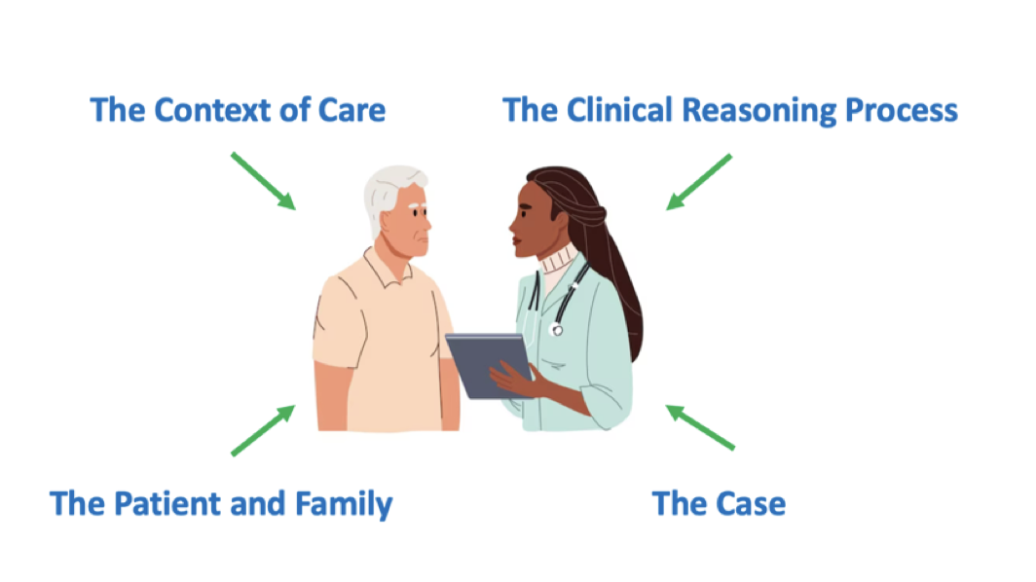
Dimensions of RCA’s of Diagnostic Error

Slide 34
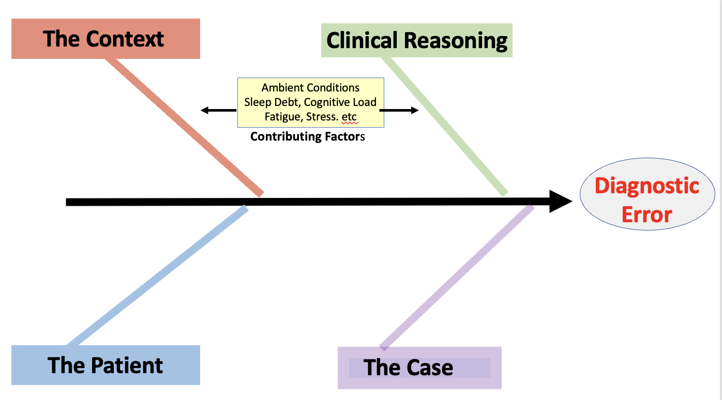
Human Factors

Slide 35
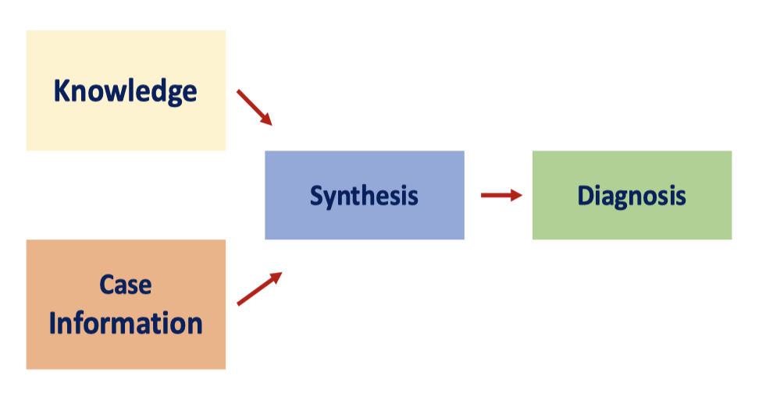
Clinical Reasoning

Slide 36
5 %
“Bias”
80 %
15 %

Slide 37
RCA’s of Diagnostic Error -- Interventions
Patient engagement
Decision support
Teamwork
Follow Up; Closing the loop
Feedback
Pause to reflect

Slide 38
ROOT CAUSE ANALYSIS OF CASES INVOLVING DIAGNOSIS
A Handbook for Healthcare Organizations
https://www.leapfroggroup.org/influencing/resources-and-media

Slide 39
First Field Report

Slide 40
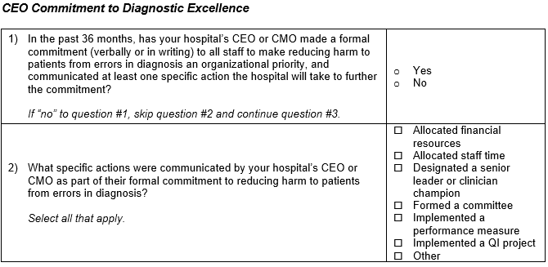
Practices Assessed in the 2024 Hospital Survey
Notes:
Before we review what we found, I wanted to quickly recap what we asked hospitals on the 2024 Hospital Survey, to assess the implementation of practices to reduce errors in diagnosis. First, we asked hospitals whether their CEO or CMO made a formal commitment to reduce errors in diagnosis, and what concrete steps they committed to.

Slide 41
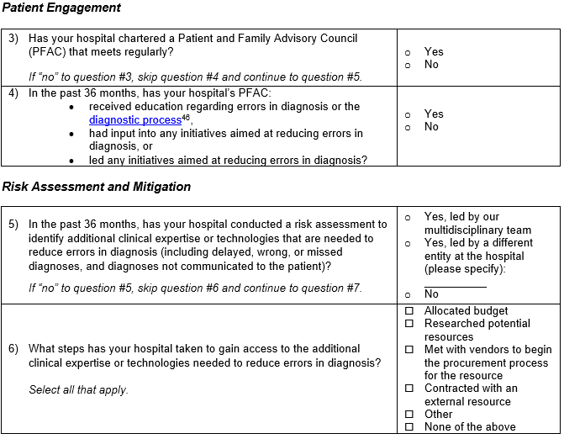
Practices Assessed in the 2024 Hospital Survey
Notes:
Next, two concepts here. First, has your hospital convened a PFAC, and then, has your hospital engaged your PFAC in diagnosis improvement work? That means engaging them in some way in an initiative.
Then, we asked about conducting an internal risk assessment. Has your hospital identified clinical expertise or technologies that might be needed to reduce errors in diagnosis, and what steps have you taken to close those gaps? It could be a new budget line item, doing some research, contracting with vendors, that kind of thing.

Slide 42
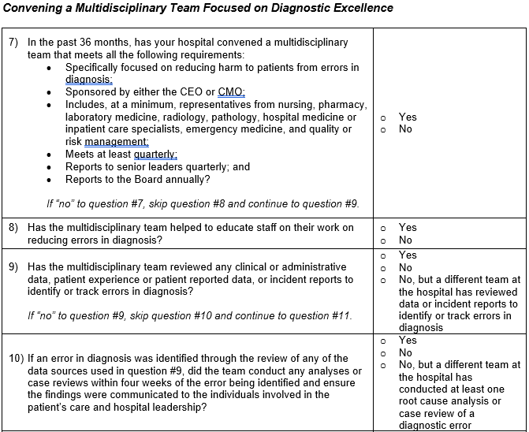
Practices Assessed in the 2024 Hospital Survey
Notes:
Now we get to what I personally think is really the core practice to reducing errors in diagnosis. That’s convening a multidisciplinary team that is specifically focused on reducing errors in diagnosis. We want that team to including representatives from a variety of disciplines that impact diagnosis – so radiology and pathology of course, but nursing, pharmacy, emergency medicine, and so on. We want them to be empowered, too – so reporting to senior leaders and the Board.
Then, in terms of identifying concrete work for that committee to do, we had a long list of things. Educating staff about their work, of course. But then it terms of the work itself – that could be scouring clinical data for errors in diagnosis and conducting root cause analyses, like Mark just talked about, or the RAND team talked about using MeasureDX.

Slide 43
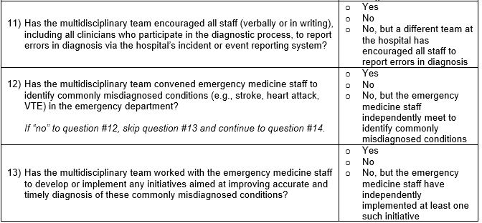
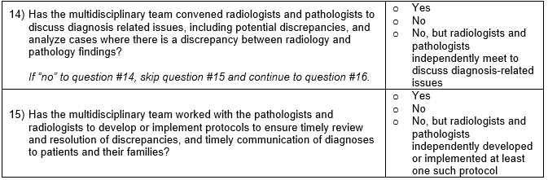
Practices Assessed in the 2024 Hospital Survey
Notes:
In question 11, that could be encouraging reporting from clinicians, so there are additional incidents that can be investigated.
In questions 12 and 13, we are asking where the team has worked with the emergency medicine staff to identify commonly misdiagnosed conditions and implemented an initiative to reduce these
And very similarly, in questions 14 and 15, we asked about whether radiologists and pathologists had opportunities to discuss discrepancies, and put together protocols to ensure the timely review of those discrepancies.

Slide 44
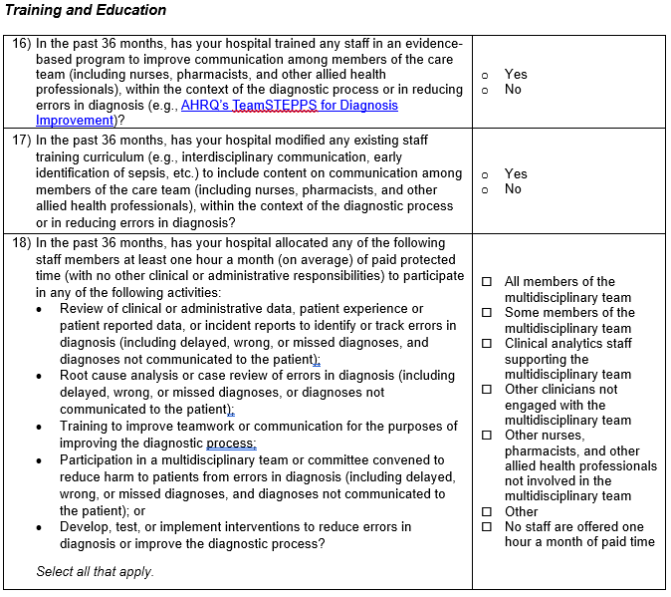
Practices Assessed in the 2024 Hospital Survey
Notes:
The last structure we asked about was training and education. Here we asked if hospitals had either trained staff in interprofessional communication as part of a care team, with a focus of diagnosis, giving the example of the AHRQ Teamstepps for Diagnosis program, or if hospitals had modified an existing communications training to focus on diagnosis.
We also asked about protected time, with the goal of trying to better understand whether staff had the time they need to complete all these projects we were asking about – either for members of that multidisciplinary team, or others involved in the process getting training, and so on.

Slide 45
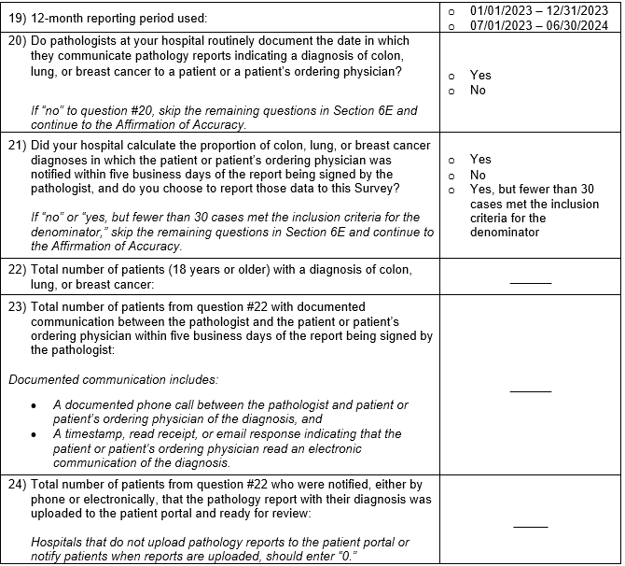
Practices Assessed in the 2024 Hospital Survey
Notes:
Finally, we also asked one “process” type set of questions – we were looking at the proportion of cancer diagnoses where hospitals are able to confirm that either the ordering physician, or the patient themselves, received the information about the diagnosis. This is what we call “closing the loop”, the final communication link between the pathologist and the person who can actually act on the diagnosis.

Slide 46
Key Themes from Optional Reporting in 2024 Hospital Survey
Meaningful opportunity for improvement
  Implementation of practices ranged from 45%-70%
  Relatively modest correlation – few hospitals are doing “all of the above”
Feedback is generally positive
  Several hospitals report that Leapfrog’s initiative has helped them make the case internally to pursue diagnostic excellence
  Some pushback on the breadth of practices
  Rate of optional reporting somewhat less than comparable cycles
Notes:
So as a reminder, this section is not publicly reported, and we aren’t scoring hospitals responses. Instead, this was a fact-finding year.
So, what did we learn from this first round?
First, we think this initiative is worth pursuing. None of the practices we asked about were “topped out” – there is still opportunity for improvement. We also found that just because a hospital is implementing a given practice, that doesn’t tell you much about whether they are implementing the others. There is a limited correlation between practices.
In terms of feedback, we did get some positive notes. By virtue of introducing diagnosis to the hospital survey, it does seem like there are many hospitals who are excited about being able to use the Survey as a tool to advocate for new initiatives in this emerging area of patient safety. That said, there was certainly pushback on the breadth of the practices we are asking about here. And that’s understandable – we’re covering everything from patient engagement to leadership commitments, and we’re asking for meaningful deliverables here – convening a team, training folks. There is an investment to be made.
I do want to also be transparent – we had somewhat fewer hospitals reporting on this optional section than we typically do – almost 40% less. That’s still the better part of a thousand hospitals, so we’re very excited about the sample size and all the many questions and reflections we’ve gotten on the Help Desk. But I think it conveys that this is an emerging area that many hospitals are not all the way comfortable reporting on, even in this fully anonymized way.
1250 for IC, 750 for diagnosis

Slide 47
Key Themes from Optional Reporting in 2024 Hospital Survey
Consistency in responses is an area of improvement
  Follow-on interviews reveal inconsistent approaches. Many hospitals that have implemented a practice without a specific focus on diagnosis, e.g.:
    CEO commitment is not specific to diagnosis, but focused on patient safety more generally
    PFAC engaged as partners in developing patient engagement material, but tangential to diagnosis
    Risk assessments concentrated on broad array of patient safety risks
    “Multidisciplinary team” same entity as established patient safety committee
  Leapfrog plans to address this by thoroughly revising the questions to be more specific:
    New language in question text and in FAQs to clearly outline what we are looking for
    Identifying specific best-in-class tools to pursue initiatives – like TeamSTEPPS for Diagnosis
Notes:
Maybe the most important finding, for my part, is that we found many cases where responses between hospitals were inconsistent. Generally speaking, this is where a hospital is engaged in the work, like making a commitment to patient safety or engaging a PFAC, but the work is not specific to diagnosis. Other examples we say include risk assessments where a broad array of patient safety risks are reviewed, or where the hospital’s existing patient safety commitment is given an additional charge to focus on diagnosis.
This really speaks to the goal of this new section of the Survey. We are hoping to spur a real movement in how diagnostic errors are approached – and that means taking a new approach. The practices we are asking about in the Hospital Survey generally need a specific focus on diagnosis to be effective – it can’t just be one more thing the patient safety committee or PFAC is working on.
We want our Survey results to reflect reality. So we are proposing a substantial re-write of the questions to get much more specific, and plan to draft new FAQs to address common questions we’ve gotten on the Help Desk. This will have the added benefit of promoting the best in class tools, like AHRQ’s TeamSTEPPS for Diagnosis.

Slide 48
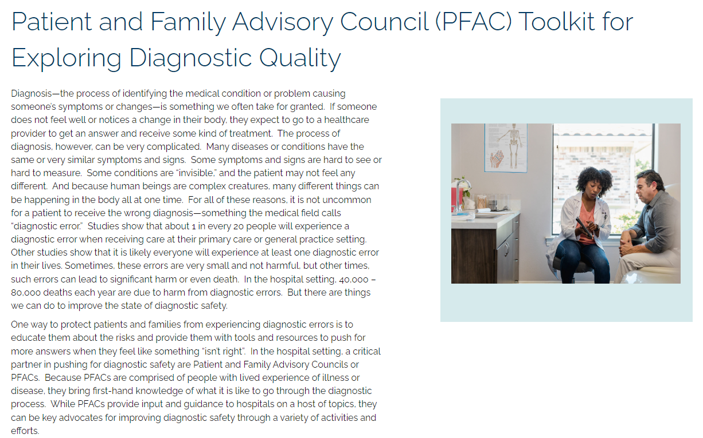
Other Resources and Tools
Notes:
So, before we move on to the Q&A, I just want to plug one more resource that you can look out for if you’re looking to get started.
Leapfrog has published the PFAC Playbook, a tool for patient and family caregiver advisory councils to help them co-create diagnostic excellence at their hospitals. It has everything you need to lead a PFAC through a diagnosis-focused initiative, including videos, worksheets, facilitator guides, examples of successful projects, and background materials on diagnostic errors. I’m confident this toolkit will be a real resource to you, and my colleague here Leah Kaufman deserves all the credit for working with Suz Schrandt and the Society to Improve Diagnosis in Medicine to produce this.

Slide 49
Q & A
Participants will be able to ask questions during the presentation. Please select the Q&A icon at the bottom of your screen:
  Once the icon has been selected a Q&A box will appear for you to type your questions.
  All participants will be able to view the questions and answers during the duration of the webinar.
    You will be receiving responses in real time from a member of our team.
    We will include a transcript of the Q&A on the Leapfrog website here: https://www.leapfroggroup.org/survey-materials/town-hall-calls
    Some questions may be answered live – please pay close attention.
Following the presentation we will have a live Q&A session. Please use the Raise Hand icon at the bottom of your screen:
  Once the icon has been selected you will be placed in the que. When it is your turn to ask your question, you will receive a prompt from the host asking you to unmute yourself.
Notes:
Alright, so with that, it’s time for the Q&A. You can go ahead and use the QandA feature, or raise your hand and then unmute yourself to ask your question when we call on you.

Slide 50
Thank you for joining us today.
Questions? Contact the Help Desk at https://leapfroghelpdesk.Zendesk.com
Notes:
If you have any questions or comments we didn’t get to, or would like to follow-up about this project, please reach out to the Help Desk and I’ll be right with you.

